Slide 1
Deep Learning
Project proposals

Slide 2
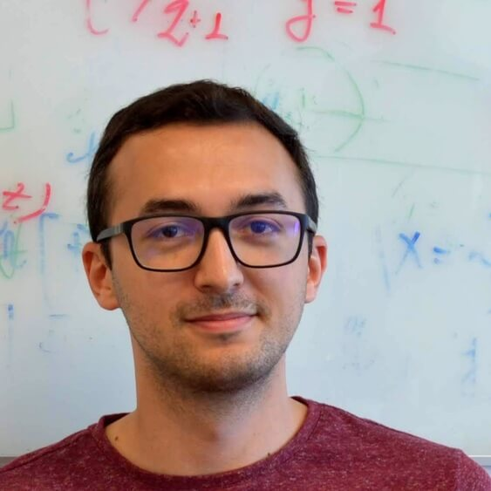
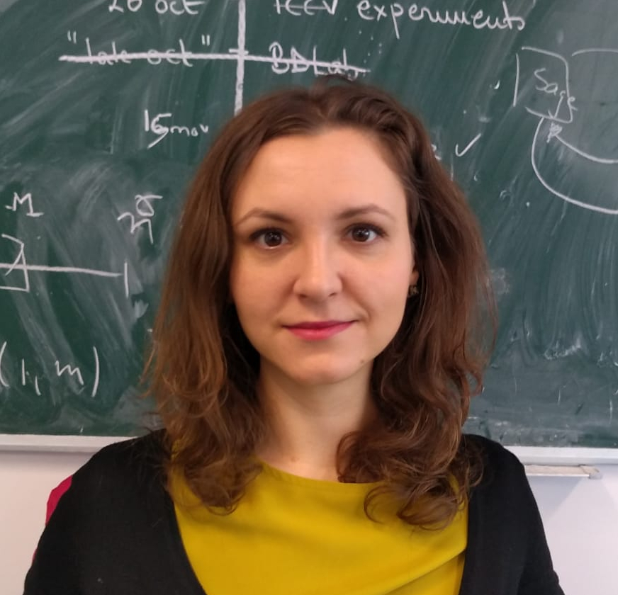
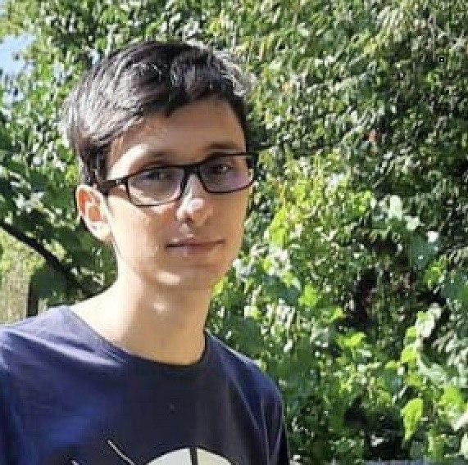
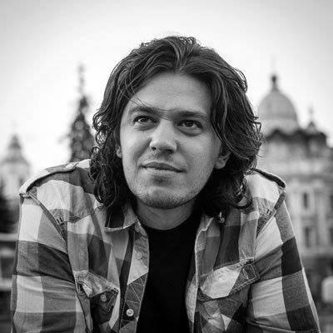
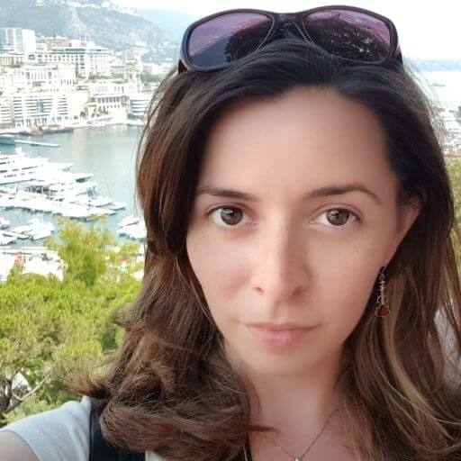
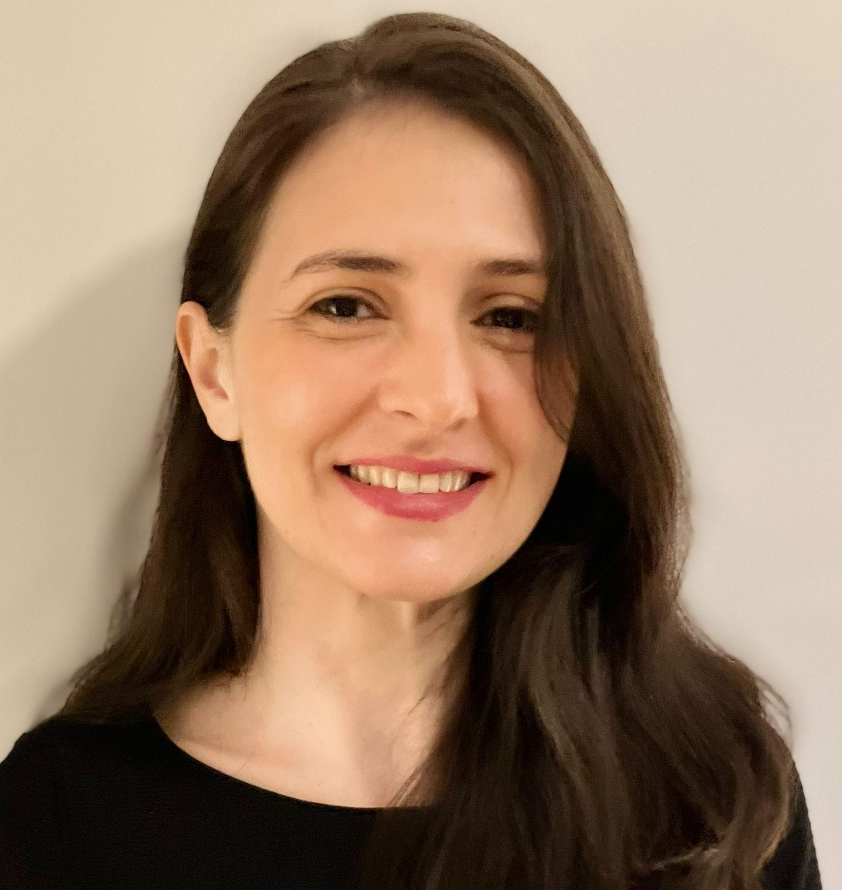
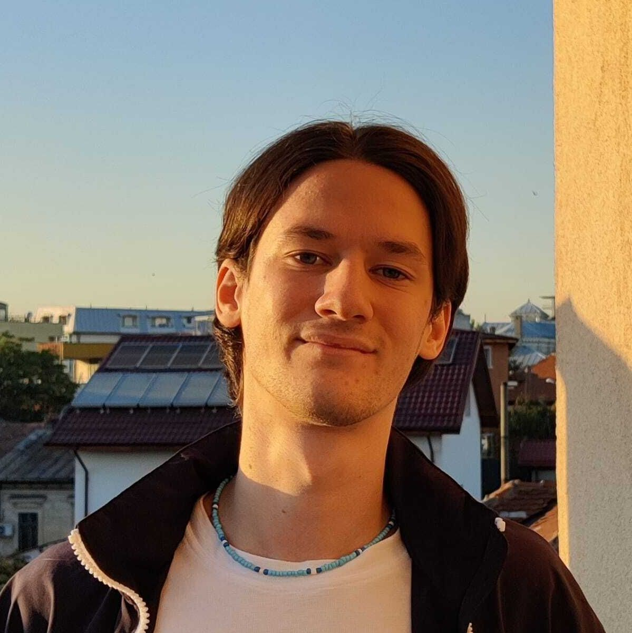
Mentors
Florin Brad
Elena Burceanu
Marius Drăgoi
Florin Gogianu
Emanuela Haller
Elisabeta Oneață
Ștefan Smeu

Slide 3
Steps for the Project
Select a project, team of 2 (hard deadline: March 31)
If you are not the first team for a project, ask the mentor if you can choose it
Follow the instructions from your mentor
Read the Related Work
Choose a Dataset
Implement several Baselines in Pytorch
Comparative Analysis - variations for:
Architecture
Number of parameters
Optimization, cost function
Poster for the Project (presented in the final week)
Bonus: Submit for eeml.eu (deadline: March 31)
Mandatory: Deep Learning approach for the chosen problem

Slide 4
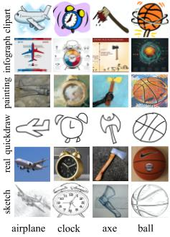
What do NNs learn (ID vs OOD)?
Goal
Do NNs generalize over distributions? How different training methods impact the feature space?
Datasets
Multi-envs datasets: PACS, DomainNet
Grading guidelines
50% - few embeds from 1 + 2
80% - 1 + 2 + few meth from 3
100% - most of 1 + 2 + most of 3
Bonus: Test methods for better OOD generalization (e.g. Lisa/Coral/heavy augmentation)
Various embeddings from backbones pre-trained and/or trained from scratch
Basic discriminative (resnet/densenet)
Generative (StableDiff/CLIP)
Contrastive (MoCov3/BYOL/ BarlowTwins)
Compare performance on downstream task (classification)
In vs Out of distribution (ID/OOD)
In-depth analysis of learned features (what is the best embedding/why?)
Visualization TSNE for features
Visualization OTDD/KL dist for distributions
Alignment vs uniformity
Most important features (backgr/fg)
{eburceanu, ssmeu}@bitdefender.com
Notes:
TODO: GOAL

Slide 5
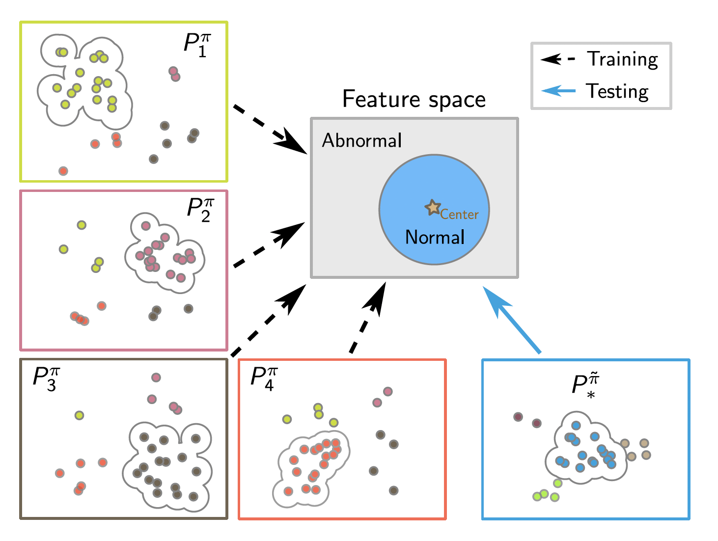
Zero-Shot Anomaly Detection
Goal
Do NNs generalize over distributions? How different training methods impact the feature space?
Dataset
Modified MNIST
Paper
Zero-Shot Anomaly Detection without Foundation Models
Grading guidelines
50% - 1 + few baselines from 2
80% - 1 + more baselines from 2
100% - 1 + 2 + 3
Bonus - it works very good :)
Build the modified dataset for the setup
Multiple envs with one main class and few anomalies (see Experimental section)
Anomaly Detection baselines
ocsvm/knn/other deep methods (see ADBench)
Implement the optimizations from the paper (for a chosen AD method)
batch normalization
env based training dynamic
{eburceanu, ssmeu}@bitdefender.com

Slide 6
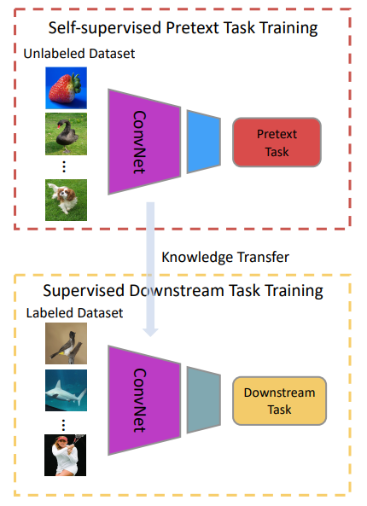
Self-Supervised Learning: Visual Features from Pretext Tasks
Goal
Learn general visual features from large-scale unlabeled data, by solving pretext tasks
Transfer knowledge to a downstream task
Datasets
CIFAR10 / MNIST / SVHN / others
Papers
https://arxiv.org/pdf/1902.06162.pdf (TPAMI 2020)
Grading guidelines
50% - understand, implement and run the self-supervised model
80% - train and analyze the model
100% - transfer knowledge to a downstream task
ehaller@bitdefender.com

Slide 7
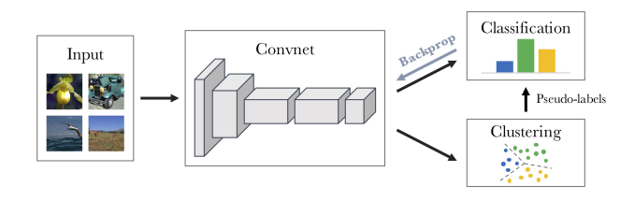
Unsupervised Deep Clustering
Goal
Learn general visual features from large-scale unlabeled data, by solving pretext tasks
Jointly learn the parameters of a neural network and the cluster assignments of the resulting features
Datasets
MNIST / CIFAR-10 / SVHN / others
Papers
https://arxiv.org/pdf/1807.05520.pdf (ECCV 2018)
Grading guidelines
50% - understand, implement and run the model
80% - train and analyze the model
100% - transfer knowledge to a downstream task
ehaller@bitdefender.com

Slide 8
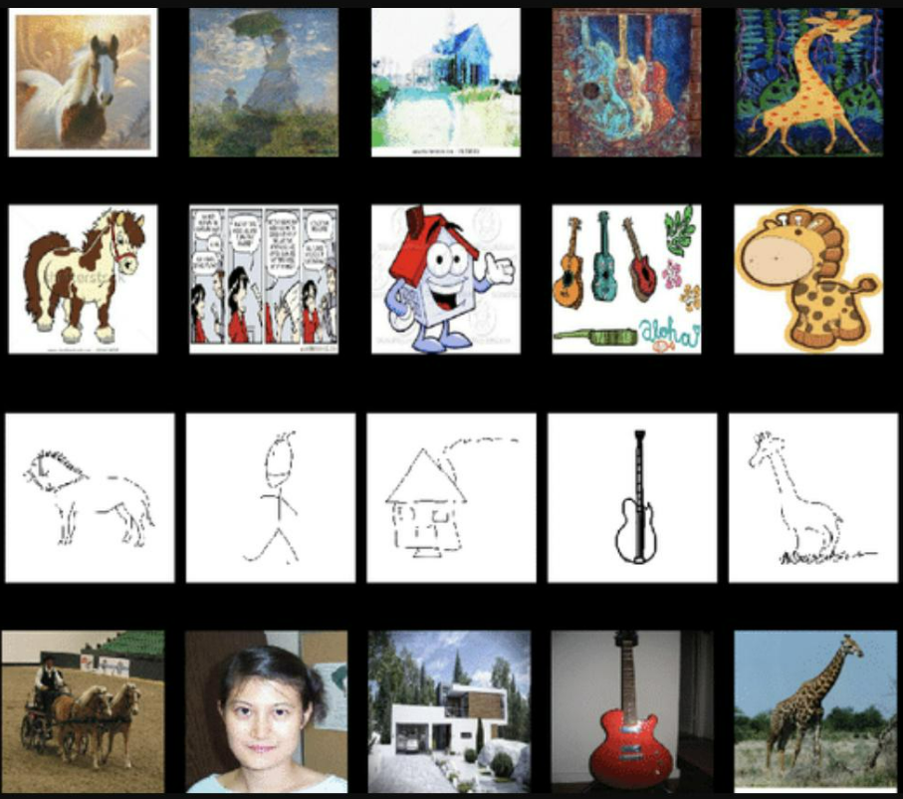
Test-Time Adaptation
Goal
Adapt to a new test distribution on the fly
Datasets
PACS / CIFAR-10-C / ImageNet-C / SVHN / MNIST / others
Papers
https://proceedings.neurips.cc/paper/2020/file/85690f81aadc1749175c187784afc9ee-Paper.pdf (NeurIPS 2020)
https://arxiv.org/pdf/2006.10726.pdf (ICLR 2021)
https://arxiv.org/pdf/2209.07522.pdf (NeurIPS 2022)
Grading guidelines
50% - understand, implement and run the model on source data
80% - highlight the problem and adapt to target data
100% - analyze the model
ehaller@bitdefender.com

Slide 9
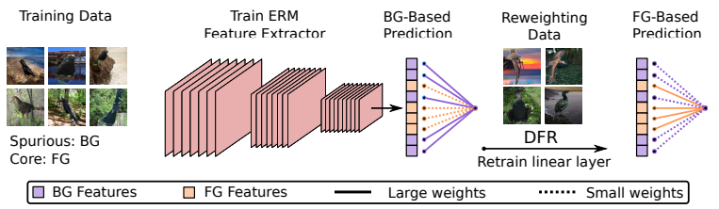
Deep Feature Reweighting
Goal
Prove that neural networks learn core features even when trained on datasets with spurious correlations (patterns that are predictive of the target in the train data, but irrelevant to the true labeling function)
Datasets
Waterbirds / CelebA / MNIST / CIFAR-10 / others
Papers
https://arxiv.org/pdf/2204.02937.pdf (ICLR 2023)
https://openreview.net/pdf?id=3OxII8ZB3A (NeurIPS 2022 Workshop on Distribution Shifts)
Grading guidelines
50% - train model with spurious correlations
80% - highlight the problem and mitigate it using DFR / DD-DFR
100% - analyze behavior
ehaller@bitdefender.com

Slide 10
Emotion Detection
why don’t you ever write me? :((
Task: given a dialogue with 3 utterances, predict which emotion is conveyed
Expectations:
Different architectures for sentence embeddings: CNN, RNN
word vs char embeddings
emoji preprocessing
Resources:
SemEval 2019 competition
https://www.humanizing-ai.com/emocontext.html
https://towardsdatascience.com/a-beginners-guide-on-sentiment-analysis-with-rnn-9e100627c02e
emotion detection
happy
sad
angry
others
fbrad@bitdefender.com

Slide 11
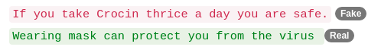
Covid Fake News Detection
Task: given a social media post discussing Covid-19, classify it as real or fake
Resources: dataset paper, dataset, task website, DL approaches paper
Grading guidelines
50% - finetune BERT on classification task directly
80% - compare several FT approaches (all layers, bias terms)
100% - compare several LM models (BERT, Covid-BERT etc.)
fbrad@bitdefender.com

Slide 12
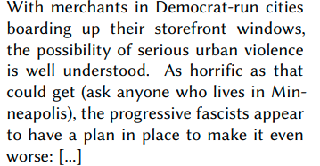
Fake News Detection
Task: given an article, predict whether the main claim is true, partially true, false or other
Resources:
task website
dataset: link1, link2
overview CLEF 2021 paper
Grading guidelines
50% - finetune BERT on classification task directly
80% - compare several FT approaches (all layers, bias terms)
100% - compare several LM models (BERT, Covid-BERT etc.)
true
partially true
false
other
fbrad@bitdefender.com
Notes:
Other related tasks: Conspiracy detection, Conspiracy stance detection https://www.cmu.edu/ideas-social-cybersecurity/news1/blog-posts/blog-phillips-hoaxes-hidden.html

Slide 13
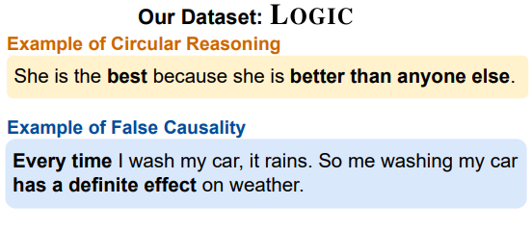
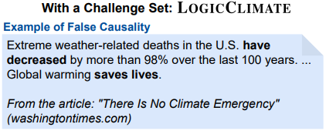
Logical fallacies detection
Task: given a Tweet, determine what logical fallacy it contains (13 classes)
Resources:
paper 1
dataset
Grading guidelines
50% - finetune LM on Logic dataset
80% - FT Logic vs FT LogicClimate vs FT Logic+LogicClimate
100% - compare several LM FT results
fbrad@bitdefender.com

Slide 14
Ad Hominem Detection
Task: given a Reddit post, determine whether it contains an Ad Hominem attack
Resources:
paper 1, paper 2
dataset
Grading guidelines
50% - finetune LM on dataset
80% - minority class reweighting analysis
100% - results analysis
Augmented recurrent neural networks, and the underlying technique of attention, are incredibly exciting. You’re so wrong and a f*ucking idiot! We look forward to seeing what happens next
ad hominem
clean
fbrad@bitdefender.com

Slide 15
Authorship Verification
Task: given 2 texts, are they written by the same author?
Resources:
competition
paper
Grading guidelines
50% - finetune BERT on dataset
80% - minority class reweighting analysis
100% - results analysis
document 1
document 2
Authorship Verification System
same author
different author
fbrad@bitdefender.com

Slide 16
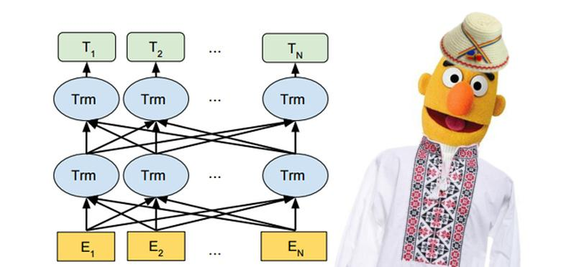
Self-Supervised Learning: Text Features from Language Modelling
Goal
Train a BERT/Romanian BERT language model on a romanian corpus
Transfer knowledge to a downstream task
Datasets
OSCAR (pretraining), LiRo (pretraining, target task)
Links
https://oscar-corpus.com/post/oscar-v22-01/
https://lirobenchmark.github.io/
https://arxiv.org/pdf/2009.08712.pdf
Grading guidelines
50% - finetune BERT on classification task directly
80% - domain-adaptive pretraining, followed by finetuning on classification task
100% - compare several LM models
Bonus: Submit a model to LiRo
fbrad@bitdefender.com

Slide 17
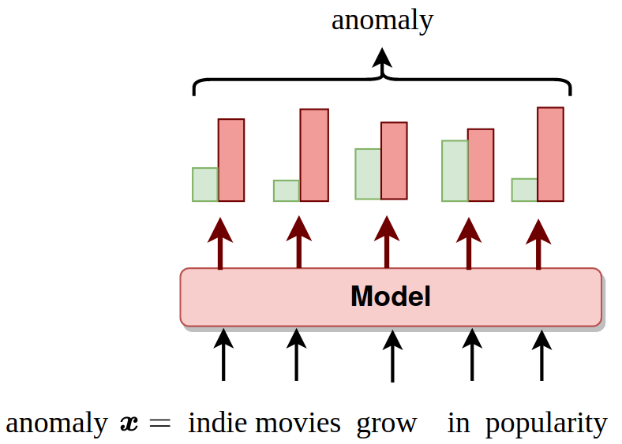
Unsupervised text anomaly detection
Resources:
https://arxiv.org/pdf/1803.04967.pdf
https://arxiv.org/pdf/1712.00557.pdf
https://arxiv.org/pdf/1812.04606.pdf
Task: Discriminate anomalies (outliers) from clean data (inliers) in an unsupervised or self-supervised fashion
Expectation:
Use a RNN (LSTM/GRU) or a Transformer Model to learn the inlier distribution.
Use the “pretext” task (e.g. language modeling, other) to detect anomalies.
Bonus: Use Outlier Exposure to improve results
Grading guidelines:
50%: Understand, train some AD models and do a comparison
80%: Build a Semi-Supervised AD deep language model
100%: Unsupervised AD
Bonus: Outlier Exposure
amanolache@bitdefender.com

Slide 18
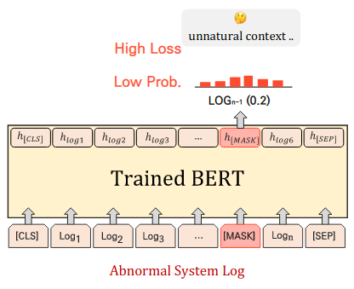
Anomaly detection in network logs
Task: Discriminate anomalous logs (outliers) from benign logs (inliers) using language modelling in unsupervised or self-supervised fashion
Expectation:
Use a RNN (LSTM/GRU) or a Transformer Model (BERT) to learn the inlier distribution
Compute an anomaly metric for the test samples and evaluate the model using ROC-AUC between your anomaly scores and dataset labels
Dataset:
CICIDS2018: https://www.unb.ca/cic/datasets/ids-2018.html
Resources:
RNN for log anomaly detection: https://arxiv.org/pdf/1803.04967.pdf
LAnoBERT: https://arxiv.org/pdf/2111.09564.pdf
OE: https://arxiv.org/pdf/1812.04606.pdf
Scoring:
80%
Correctly train a simple model in the given setup
Correct plots for train/test splits
100%
Obtain good performance
Analyze anomaly detection rate based on outlier class (CICIDS2018 labels: Bruteforce attack, DoS attack, Botnet attack etc.)
Comparison: split data by timestamp (test on different period than the train data) vs random split
Bonus: Outlier Exposure
Anomaly score computation (Source: LAnoBERT)
mdragoi@bitdefender.com

Slide 19
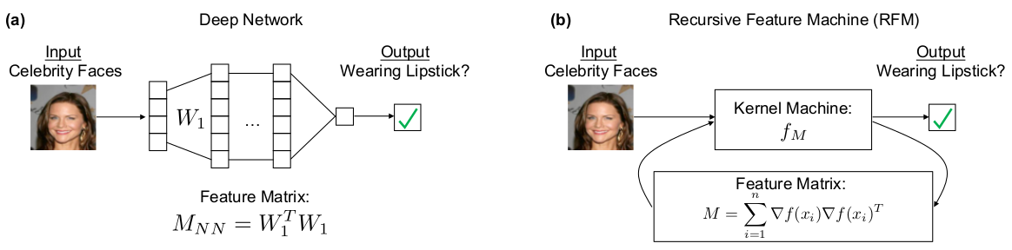
Feature learning with RFMs and MLPs
Task: Compare Recursive Feature Machines (RFMs) with multi-layer perceptrons (MLPs)
Expectation:
Compare RFMs with MLPs on tabular and image classification tasks
Vary dataset size, see what happens when we increase the number of samples
Datasets:
Tabular: HIGGS
Images: CIFAR-10/100
Resources:
RFMs: https://arxiv.org/pdf/2212.13881.pdf
https://github.com/aradha/recursive_feature_machines/blob/main/rfm.py
Scoring:
80%
Use RFMs to classify data in the two datasets
Vary dataset size, plot the evolution of the accuracy gap
100%
RFM and MLP accuracy gap evolution with MLP depth increase
Bonus
Plot evolution of RMSE between the top eigenvalue of MLP and RFM features across dataset size
mdragoi@bitdefender.com

Slide 20
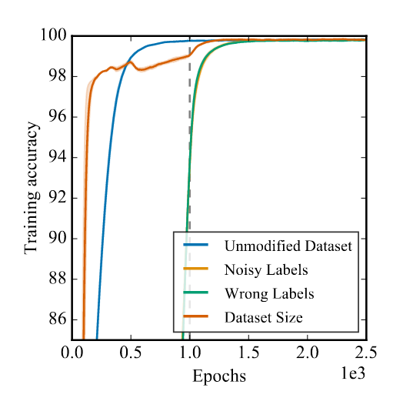
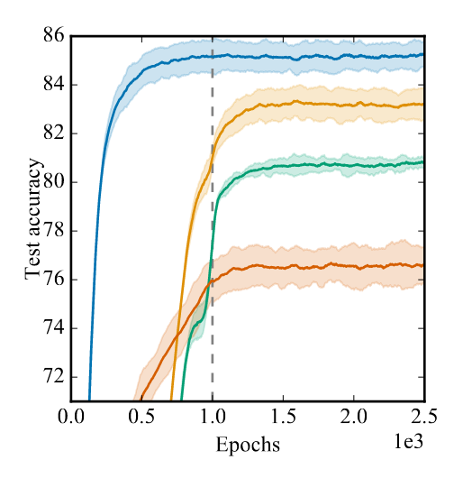
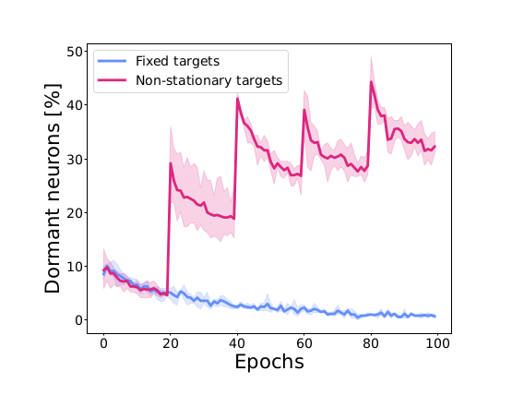
Loss of plasticity in neural networks
Goal: Observe the loss of performance when a neural network is trained on a shifting distribution of labels. Figure out ways to fix it :)
Tasks:
[50%] Train a CNN model on CIFAR-like datasets, but with under target distribution shift. Observe the loss in performance.
[80%] Measure the activation score of each neuron during training.
[100%] Try to improve the model using regularization
L1/L2, Dropout
ReDO
Spectral Normalisation.
Final grade is not conditional on your results but on the quality
of your experiments and reporting.
https://arxiv.org/abs/2302.12902, https://arxiv.org/abs/2006.05826,
https://arxiv.org/abs/2206.10011
fgogianu@bitdefender.com

Slide 21
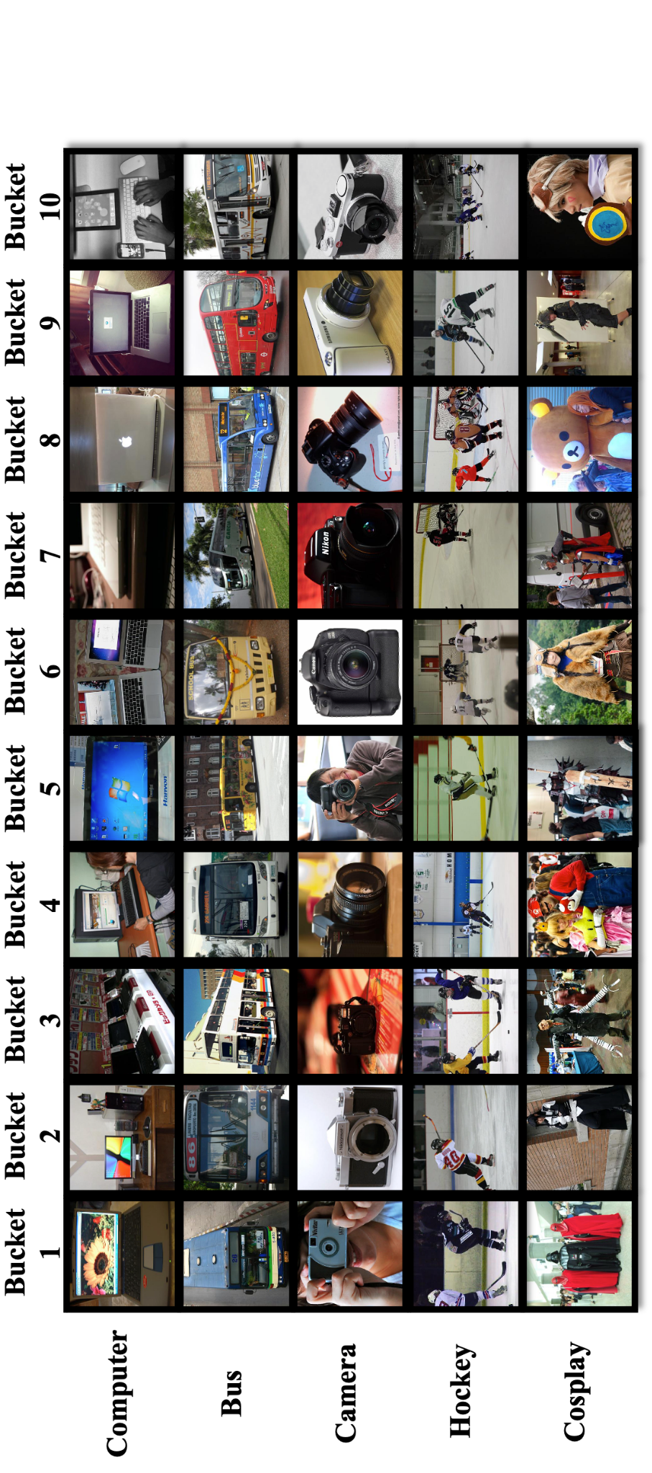
Continual learning
Goal: Preserve performance on old tasks when learning new ones.
Tasks:
[80%] Choose 3-4 separate classification tasks (different datasets: CIFAR-10, CINIC-10). Train the same network on all tasks in sequence (one after the other). Observe how the model forgets old tasks as it learns a new one. Or just train on CLEAR.
[100%] Now train using (one or two) methods that prevents forgetting:
L1,L2 regularisation, dropout
Spectral Normalisation
Synaptic Intelligence / Elastic Weight Consolidation
Progressive Nets / Progress & Compress
Links:
https://deepmind.com/blog/enabling-continual-learning-in-neural-networks/
https://deepmind.com/research/publications/progressive-neural-networks/
https://clear-benchmark.github.io/
fgogianu@bitdefender.com

Slide 22
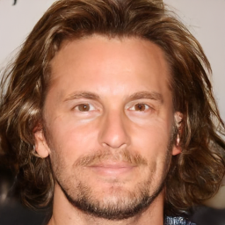
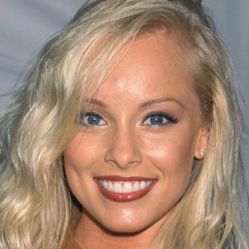
Deep Fake Image Detection
Real/Fake?
Task
Test different backbone architectures for deep fake detection of face images. Check how the models trained to detect a particular type of fakes transfer to other generation methods. (e.g. models trained on gan-generated images transfer to diffusion-generated images).
Datasets
CelebAHQ
StyleGan2 sampled images
LDM sampled images
P2 sampled images
(maybe) Face Forensics ++
Links
CNN-generated images are surprisingly easy to spot... for now
Are GAN generated images easy to detect? A critical analysis of the state-of-the-art.
What makes fake images detectable? Understanding properties that generalize
Towards the detection of diffusion model deepfakes
eoneata@bitdefender.com

Slide 23
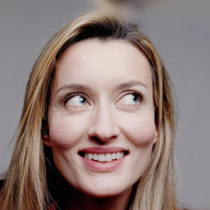
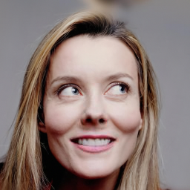
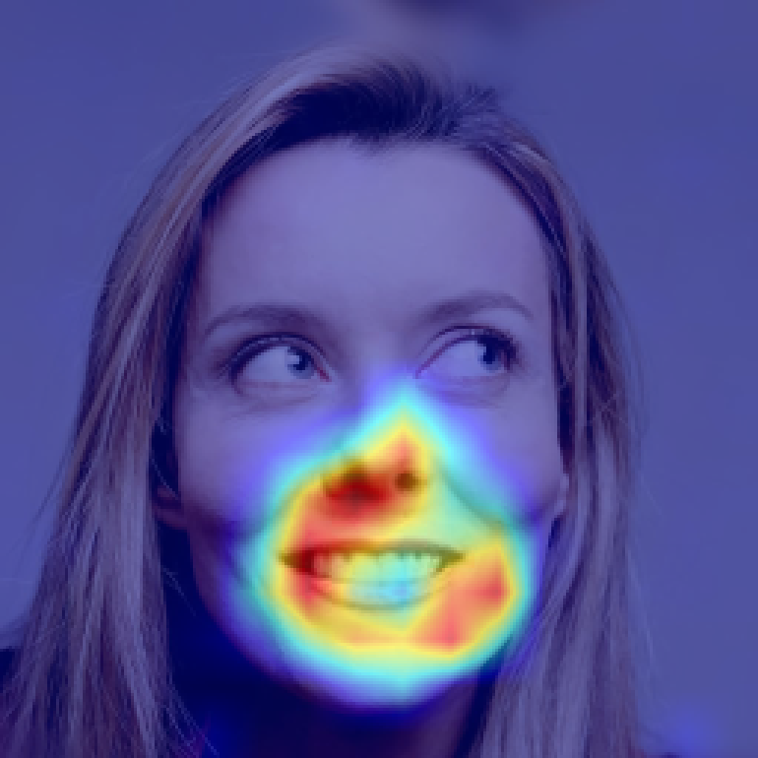
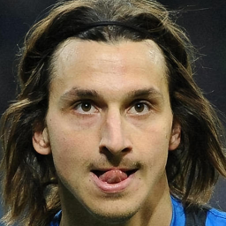
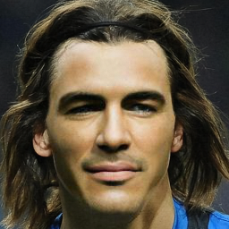
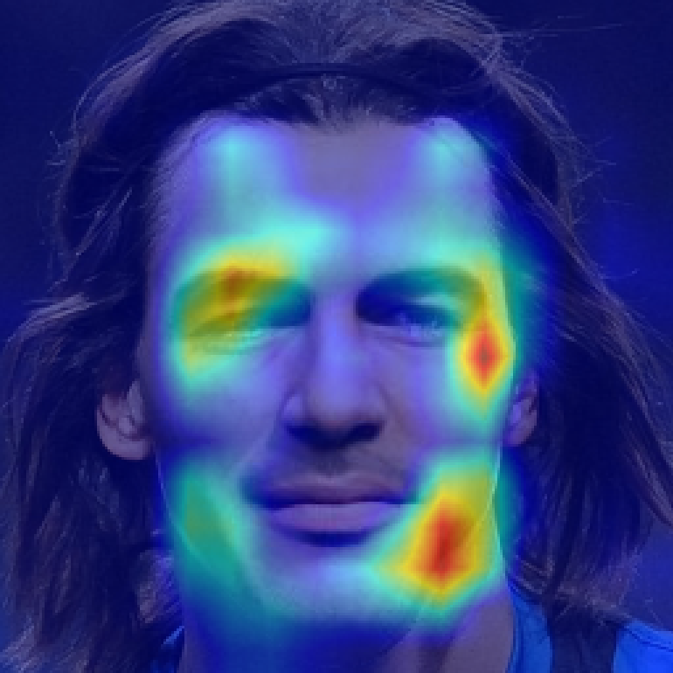
Deep Fake Localization
Task
Train networks for deep fake localization. You will experiment with different networks for image segmentation and analyze how results transfer from one deep fake generation method to another.
Datasets
Repaint
LAMA
Pluralistic
Links
CNN-generated images are surprisingly easy to spot... for now
Are GAN generated images easy to detect? A critical analysis of the state-of-the-art.
What makes fake images detectable? Understanding properties that generalize
Towards the detection of diffusion model deepfakes
eoneata@bitdefender.com

Slide 24
Images courtesy of...
https://20bn.com/datasets/jester
https://github.com/maximecb/gym-minigrid
https://www.elmundotech.com/2015/02/25/googles-deep-mind-creates-an-ai-system-to-beat-video-games-by-itself/
https://aws.amazon.com/blogs/machine-learning/detecting-fraud-in-heterogeneous-networks-using-amazon-sagemaker-and-deep-graph-library/
https://www.dynamicciso.com/dark-nexus-the-evolving-iot-botnet-targets-variety-of-devices-says-bitdefender-research/
https://studentwork.prattsi.org/infovis/visualization/amazon-product-co-purchasing-network-information-visualization/
https://github.com/tkarras/progressive_growing_of_gans

